Slide 1
MVC Architecture for Web Application
(Model-View-Controller)

Slide 2
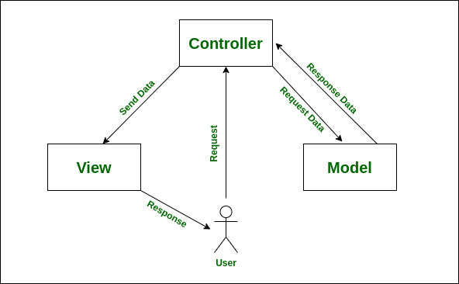
MVC Architecture

Slide 3

Models
Java Classes (Objects)
Data Tables(not in J2EE)

Slide 4

Views
routes (“/”, or “/about” );
HTML ?
JSP ?

Slide 5

Controllers
Servlets

Slide 6
MVC Architecture

Slide 7



Frameworks with MVC
Advantage
Modularity: Divides application into three interconnected components.
Scalability: Easier to scale due to modular structure.
Reusability: Components can often be reused across projects.
Testability: Each component can be tested independently.
Separation of Concerns: Clear division between presentation, business, and application logic.
Parallel Development: Multiple developers can work on different components simultaneously.
Flexibility: Allows for the use of different technologies for each component.

Slide 8
Security Advantages:
Encapsulation: MVC limits access to sensitive data and operations.
Authentication: Controllers manage authentication separately.
Input Sanitization: Controllers can sanitize user input.
Secure Communication: MVC supports secure communication protocols.
Framework Features: MVC frameworks offer built-in security features.
Handling SQL:
Model Component: Manages data storage and retrieval, often with SQL.
ORM: Abstracts SQL queries, but SQL knowledge is still crucial.
Data Integrity: SQL ensures data integrity and ACID properties.
Performance Optimization: SQL is essential for optimizing database queries.

Slide 9
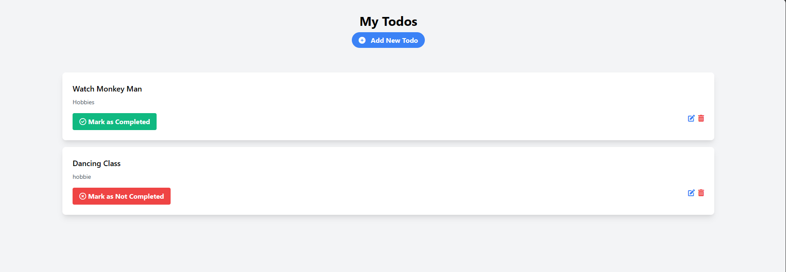
Let’s make a Todo Application using MVC in J2EE

Slide 10
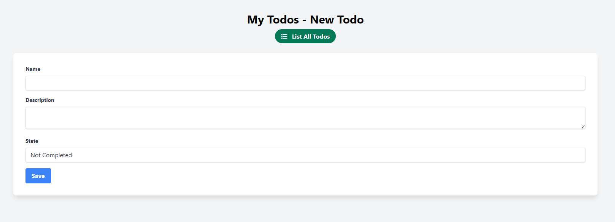

Slide 11
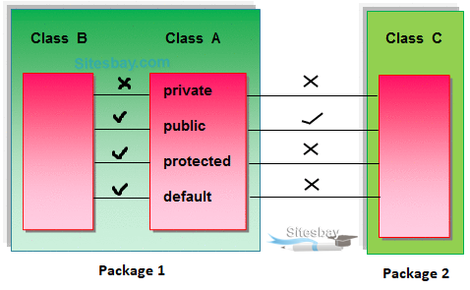
Todo Model
Access Modifiers
Properties
Constructors
Getters and Setters

Slide 12

Data Access Object (DAO) Outdated Method
private String jdbcURL = "jdbc:mysql://localhost:3306/todo?useSSL=false";
private String jdbcUsername = "root";
private String jdbcPassword = "pass";
private static final String INSERT_TODO_SQL = "INSERT INTO todos (name, description, state) VALUES (?, ?, ?)";
private static final String SELECT_TODO_BY_ID = "SELECT * FROM todos WHERE id=?";
private static final String SELECT_ALL_TODOS = "SELECT * FROM todos";
private static final String DELETE_TODO_SQL = "DELETE FROM todos WHERE id=?";
private static final String UPDATE_TODO_SQL = "UPDATE todos SET name=?, description=?, state=? WHERE id=?";
Get the full dao file -> gist.github.com/srimalonline

Slide 13
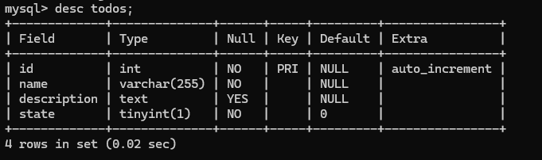
Database Creation
CREATE TABLE todos (
id INT AUTO_INCREMENT PRIMARY KEY,
name VARCHAR(255) NOT NULL,
description TEXT,
state BOOLEAN NOT NULL DEFAULT FALSE
);

Slide 14
Views with JSP (Java Server Pages)
<%@ page language="java" contentType="text/html; charset=UTF-8"
pageEncoding="UTF-8"%>
<p>Hello, <%= request.getParameter("name") %>!</p>

Slide 15
URL Rewrite – In Servlet
Using RequestDispatchers
protected void doGet(HttpServletRequest request, HttpServletResponse response)
throws ServletException, IOException {
RequestDispatcher dispatcher = request.getRequestDispatcher("/WEB-INF/views/home.jsp");
dispatcher.forward(request, response);
}

Slide 16
Controller - Servlet
@WebServlet(name = "TodoServlet", urlPatterns = {"/"})
public class TodoServlet extends HttpServlet {
private TodoDAO todoDAO;
@Override
public void init() {
todoDAO = new TodoDAO();
}

Slide 17
@Override
protected void doGet(HttpServletRequest request, HttpServletResponse response)
throws ServletException, IOException {
String action = request.getServletPath();
try {
switch (action) {
case "/new" -> showNewForm(request, response);
case "/insert" -> insertTodo(request, response);
case "/delete" -> deleteTodo(request, response);
case "/edit" -> showEditForm(request, response);
case "/update" -> updateTodo(request, response);
default -> listTodo(request, response);
}
} catch (SQLException ex) {
throw new ServletException(ex);
}
}

Slide 18
@Override
protected void doPost(HttpServletRequest request, HttpServletResponse response)
throws ServletException, IOException {
doGet(request, response);
}

Slide 19
private void listTodo(HttpServletRequest request, HttpServletResponse response)
throws SQLException, IOException, ServletException {
List<Todo> listTodo = todoDAO.selectAllTodos();
request.setAttribute("listTodo", listTodo);
RequestDispatcher dispatcher = request.getRequestDispatcher("/WEB-INF/views/todo-list.jsp");
dispatcher.forward(request, response);
}

Slide 20
private void showNewForm(HttpServletRequest request, HttpServletResponse response)
throws ServletException, IOException {
RequestDispatcher dispatcher = request.getRequestDispatcher("/WEB-INF/views/todo-form.jsp");
dispatcher.forward(request, response);
}

Slide 21
private void showEditForm(HttpServletRequest request, HttpServletResponse response)
throws SQLException, ServletException, IOException {
int id = Integer.parseInt(request.getParameter("id"));
Todo existingTodo = todoDAO.selectTodo(id);
RequestDispatcher dispatcher = request.getRequestDispatcher("/WEB-INF/views/todo-form.jsp");
request.setAttribute("todo", existingTodo);
dispatcher.forward(request, response);
}

Slide 22
private void insertTodo(HttpServletRequest request, HttpServletResponse response)
throws SQLException, IOException {
String name = request.getParameter("name");
String description = request.getParameter("description");
boolean state = Boolean.parseBoolean(request.getParameter("state"));
Todo newTodo = new Todo(name, description, state);
todoDAO.insertTodo(newTodo);
response.sendRedirect(request.getContextPath() + "/");
}

Slide 23
private void updateTodo(HttpServletRequest request, HttpServletResponse response)
throws SQLException, IOException {
int id = Integer.parseInt(request.getParameter("id"));
String name = request.getParameter("name");
String description = request.getParameter("description");
boolean state = Boolean.parseBoolean(request.getParameter("state"));
Todo todo = new Todo();
todo.setId(id);
todo.setName(name); // Set the name parameter in the Todo object
todo.setDescription(description); // Set the description parameter in the Todo object
todo.setState(state);
todoDAO.updateTodo(todo);
response.sendRedirect(request.getContextPath() + "/");
}

Slide 24
private void updateTodo(HttpServletRequest request, HttpServletResponse response)
throws SQLException, IOException {
int id = Integer.parseInt(request.getParameter("id"));
String name = request.getParameter("name");
String description = request.getParameter("description");
boolean state = Boolean.parseBoolean(request.getParameter("state"));
Todo todo = new Todo();
todo.setId(id);
todo.setName(name); // Set the name parameter in the Todo object
todo.setDescription(description); // Set the description parameter in the Todo object
todo.setState(state);
todoDAO.updateTodo(todo);
response.sendRedirect(request.getContextPath() + "/");
}

Slide 25
private void deleteTodo(HttpServletRequest request, HttpServletResponse response)
throws SQLException, IOException {
int id = Integer.parseInt(request.getParameter("id"));
todoDAO.deleteTodo(id);
response.sendRedirect(request.getContextPath() + "/");
}

Slide 26
private void deleteTodo(HttpServletRequest request, HttpServletResponse response)
throws SQLException, IOException {
int id = Integer.parseInt(request.getParameter("id"));
todoDAO.deleteTodo(id);
response.sendRedirect(request.getContextPath() + "/");
}

Slide 27

Get the UI for JSP Pages -> gist.github.com/srimalonline
find todo-list.jsp and todo-form.jsp

Slide 28

Q/A - Java EE ?

